Slide 1
UNIT 10 Live Session
Regression Continued: Ch 7 and Ch 8
Confidence and Prediction Intervals
Calibration Intervals

Slide 2
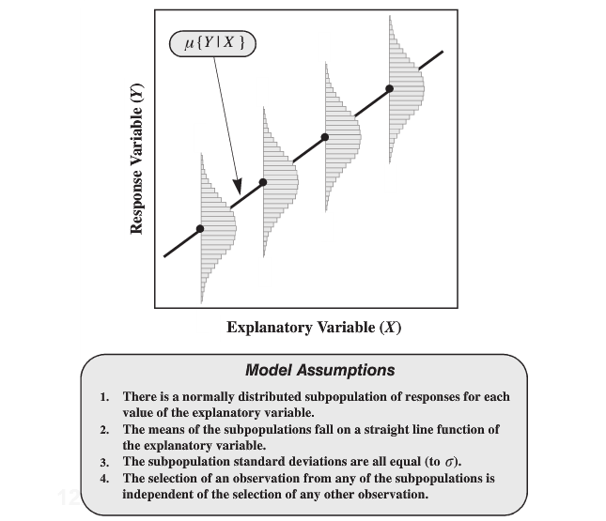
Assumptions

Slide 3
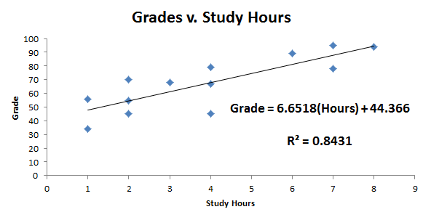
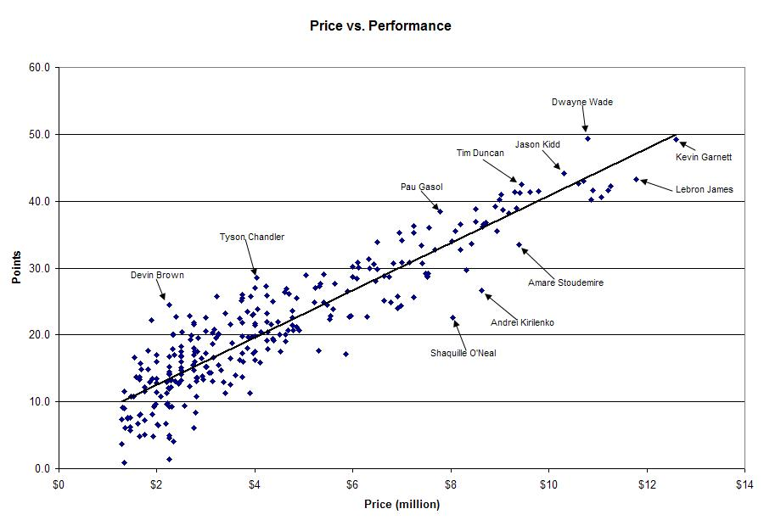
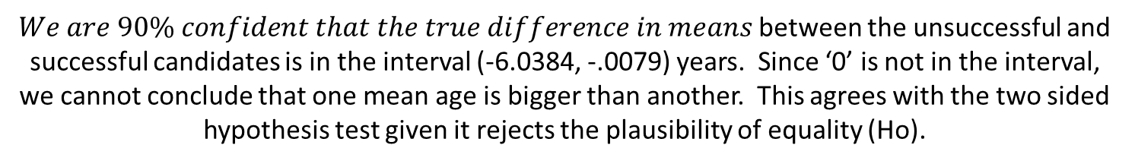
Recall two regression problems already considered…
$\hat{μ}\{Grade|Hours\}$=6.6518(Hours) + 44.366
$\hat{μ}\{Points|Price\}$= 3(Price) + 6

Slide 4
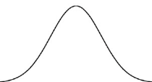

Assumptions
$\hat{μ}\{Points|Price\}$= 3(Price) + 6
There is an NBA salary cap &
only so many points can be scored in a game…

Slide 5
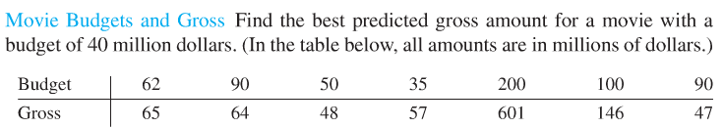
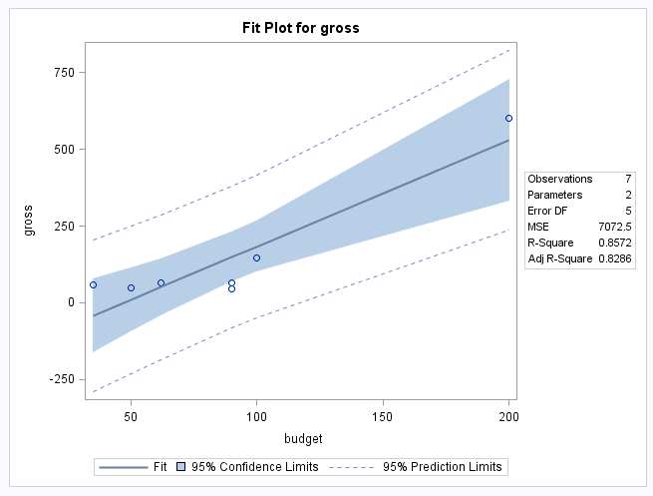
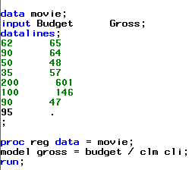
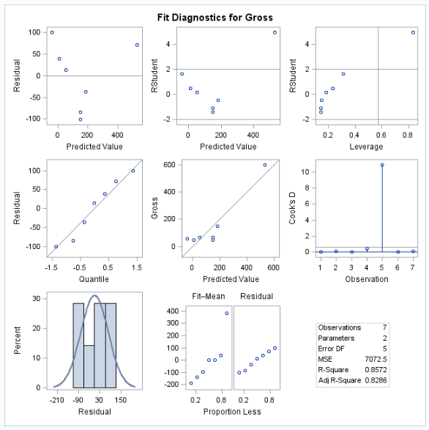
Movies: Assumptions
Assumptions:
Linearity: Questionable, but small sample size; we will proceed.
(Look at scatter plot.)
Normality: Not strong evidence against normality of residuals looking at histogram and Q-Q plot of residuals.
Equal SD: Tough to tell with such small sample size. (Look at residual vs. budget or predicted value.)
Independence: We will assume independence although that is in question as well. (Look at residual vs. budget or predicted value and data collection methods.)
Extra Caution: There appears to be at least 1 very influential point. Additional analysis should be focused on this point.

Slide 6
Regression
Confidence Intervals
Prediction Intervals
Calibration Intervals

Slide 7
Review
Movie Data

Slide 8
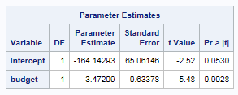
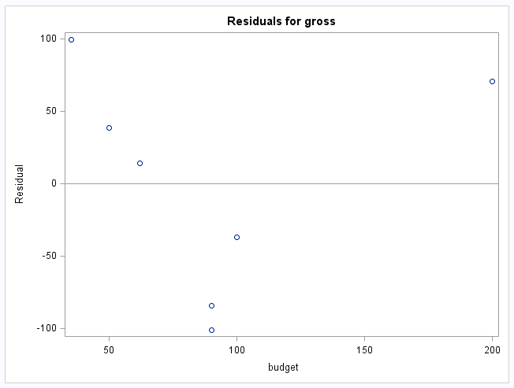

Movies
Equation of Regression Line
Pred Gross = 3.472 * Budget – 164.14
Predicted Gross for a Budget of $40 million =
$\hat{y}$₄₀=3.472(40) – 164.14 = -25 million!

Slide 9
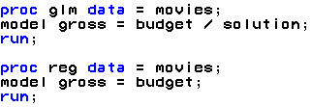
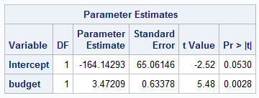

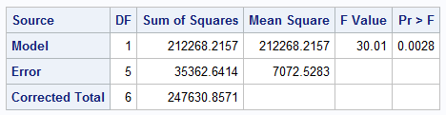
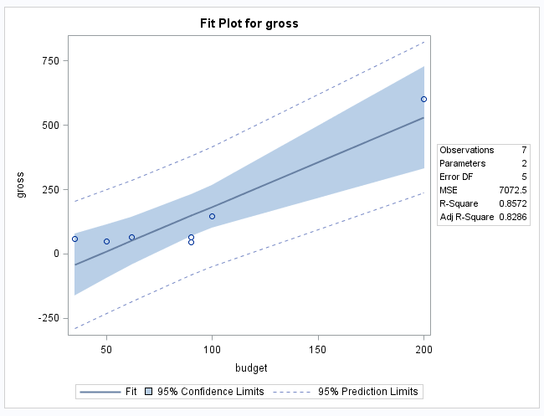

SAS at the MOVIES!
$${\hat{σ}}^{2}$$
Remember that this is the estimate of the constant variance.

Slide 10
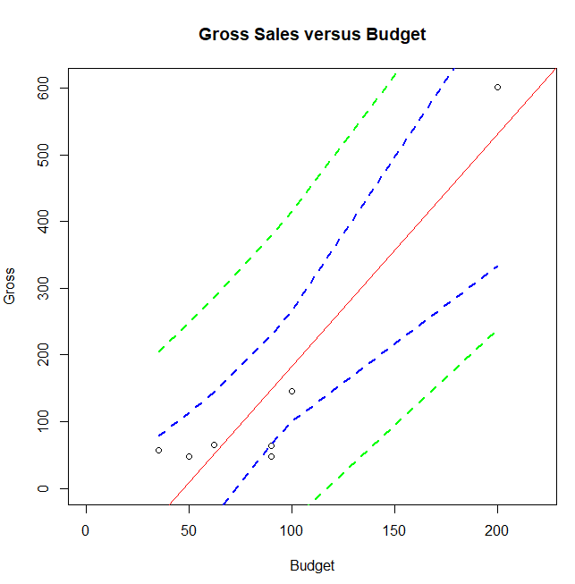
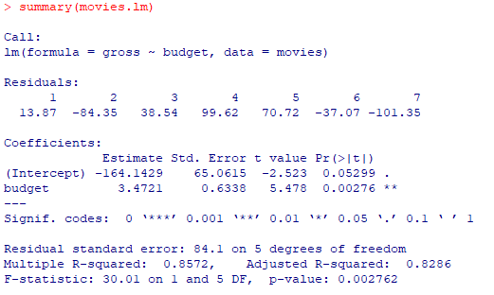
R at the Movies!
#confidence and prediction intervals
movies = read.csv("C:/Users/User/Desktop/Movies.csv")
movies
movies.lm=lm(gross~budget, data = movies)
newx=movies$budget
newx=sort(newx)
prd_c=predict(movies.lm, newdata= data.frame(budget = newx), interval=c("confidence"), type = c("response"), level=0.95)
prd_c
newpoint <- data.frame(gross=NA, budget=95)
predict(movies.lm, newpoint, interval="confidence", level = 0.95)
prd_p=predict(movies.lm, newdata= data.frame(budget = newx), interval=c("prediction"), type = c("response"), level=0.95)
prd_p
predict(movies.lm, newpoint, interval="prediction", level = 0.95)
#Plot with confidence and prediction intervals
plot(movies[,1],movies[,2],xlim = c(0,220), ylim = c(0,605),xlab = "Budget",ylab = "Gross", main = "Gross Sales versus Budget")
abline(movies.lm, col = "red")
lines(newx,prd_c[,2],col = "blue",lty = 2, lwd = 2)
lines(newx,prd_c[,3],col = "blue", lty = 2, lwd = 2)
lines(newx,prd_p[,2],col = "green", lty = 2, lwd = 2)
lines(newx,prd_p[,3],col = "green", lty = 2, lwd = 2)
Investr package documentation: https://cran.r-project.org/web/packages/investr/investr.pdf

Slide 11

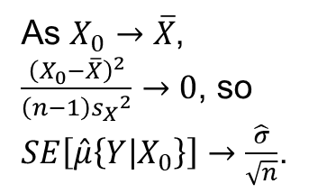
Confidence Intervals
As $X_{0}→\overline{X}$,
$\frac{{\left(X_{0}−\overline{X}\right)}^{2}}{\left(n−1\right){s_{X}}^{2}}→0$, so
$SE\left[\hat{μ}\left\{Y | X_{0}\right\}\right]→\frac{\hat{σ}}{\sqrt{n}}$.
0
Typo in book; should read df = n-2.

Slide 12
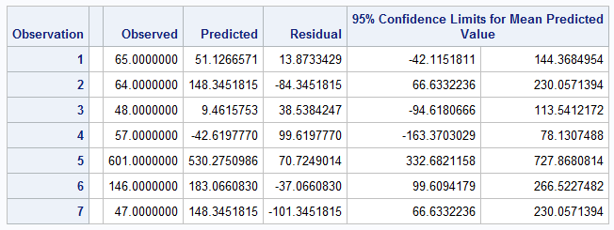

Confidence Intervals: SAS Proc glm
Typo in book; should read df = n-2.
Confidence Intervals
Budgets | Est Value | SE Est Value | Lower Lim | Upper Lim
35 | -42.61978 | 46.9740057 | -163.370303 | 78.13074882
65 | 61.542928 | 35.3959431 | -29.4452408 | 152.531096
95 | 165.70563 | 31.9718347 | 83.5194147 | 247.8918499
125 | 269.86834 | 38.9170078 | 169.828984 | 369.9076903
155 | 374.03104 | 52.282405 | 239.722664 | 508.3394195
185 | 478.19375 | 68.3244731 | 302.560097 | 653.8273956
200 | 530.2751 | 76.8670268 | 332.682116 | 727.8680814
Must match up x-value with observed value.

Slide 13
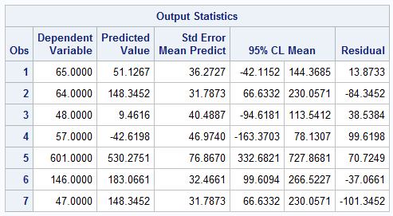

Confidence Intervals: SAS Proc reg
Typo in book; should read df = n-2.
Confidence Intervals
Budgets | Est Value | SE Est Value | Lower Lim | Upper Lim
35 | -42.61978 | 46.9740057 | -163.370303 | 78.13074882
65 | 61.542928 | 35.3959431 | -29.4452408 | 152.531096
95 | 165.70563 | 31.9718347 | 83.5194147 | 247.8918499
125 | 269.86834 | 38.9170078 | 169.828984 | 369.9076903
155 | 374.03104 | 52.282405 | 239.722664 | 508.3394195
185 | 478.19375 | 68.3244731 | 302.560097 | 653.8273956
200 | 530.2751 | 76.8670268 | 332.682116 | 727.8680814
Must match up x-value with observed value.

Slide 14
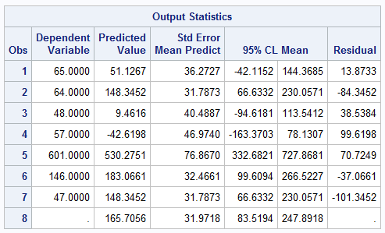
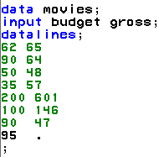

Confidence Intervals when X is not in data
Typo in book; should read df = n-2.
Confidence Intervals
Budgets | Est Value | SE Est Value | Lower Lim | Upper Lim
35 | -42.61978 | 46.9740057 | -163.370303 | 78.13074882
65 | 61.542928 | 35.3959431 | -29.4452408 | 152.531096
95 | 165.70563 | 31.9718347 | 83.5194147 | 247.8918499
125 | 269.86834 | 38.9170078 | 169.828984 | 369.9076903
155 | 374.03104 | 52.282405 | 239.722664 | 508.3394195
185 | 478.19375 | 68.3244731 | 302.560097 | 653.8273956
200 | 530.2751 | 76.8670268 | 332.682116 | 727.8680814
We are 95% confident that the mean gross when the budget is $95 million is between $83.5 and $247.9 million.

Slide 15
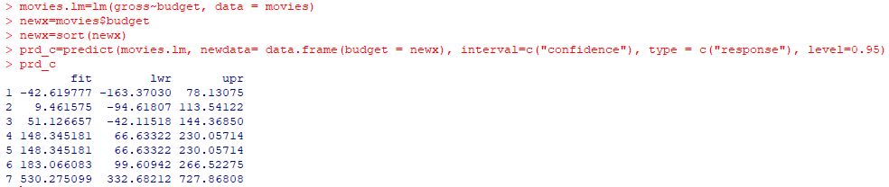

Confidence Intervals: R
Confidence intervals for the mean of Y when the X is in the original data set:
Confidence intervals for the mean of Y when the X is NOT in the original data set:

Slide 16




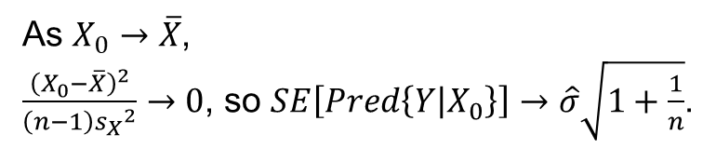

Prediction Intervals
$$μ\left(Y | X_{0}\right)$$
$$Y|X_{0}$$
Are the dotted lines parallel or bent?
0
As $X_{0}→\overline{X}$,
$\frac{{\left(X_{0}−\overline{X}\right)}^{2}}{\left(n−1\right){s_{X}}^{2}}→0$, so $SE\left[Pred\left\{Y | X_{0}\right\}\right]→\hat{σ}\sqrt{1+\frac{1}{n}}$.

Slide 17
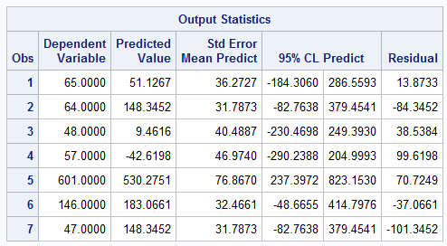

Prediction Intervals
Prediction Intervals
Budgets | Est Value | SE Est Value | Lower Lim | Upper Lim
35 | -42.61978 | 96.32801 | -290.23881 | 204.9992556
65 | 61.542928 | 91.2436358 | -173.006305 | 296.0921605
95 | 165.70563 | 89.970698 | -65.5714098 | 396.9826744
125 | 269.86834 | 92.6664005 | 31.661771 | 508.0749029
155 | 374.03104 | 99.0071054 | 119.525175 | 628.5369083
185 | 478.19375 | 108.354796 | 199.658875 | 756.7286177
200 | 530.2751 | 113.93449 | 237.397167 | 823.15303
We are 95% confident that the gross (of a single movie) when the budget is $200 million will be between $237 and $823 million.

Slide 18
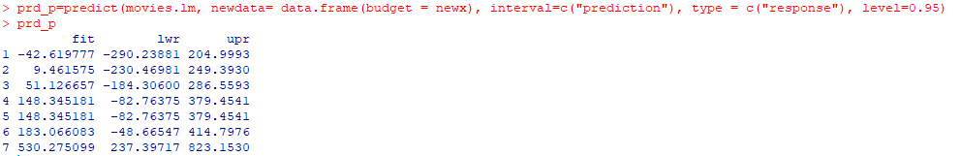
Prediction Intervals: R
Prediction intervals for an individual Y when the X is in the original data set:
Prediction intervals for an individual Y when the X is NOT in the original data set:

Slide 19
Calibration Interval (mean gross)
Graphical Method
What is a 95% confidence interval for the budget when the mean of the gross sales is $210M?
We are 95% confident that the estimated budget that would be needed to gross a mean of $210 million is between $80 and $157 million.

Slide 20
Calibration Interval (actual gross)
Graphical Method
What is a 95% confidence interval for the budget when the gross sales of an individual movie is $245M?
We are 95% confident that the budget required for a single movie to gross $245 million is between $25 million and $200 million.

Slide 21




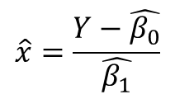
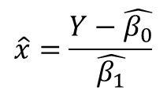

Calibration Interval (by hand)
Mean of Y
Calibration Interval (For Mean of Gross)
Est. Gross | Budget | SE Est Value | Lower Lim | Upper Lim
-43 | 35 | 13.5290282 | 0.22252578 | 69.77747422
62 | 65 | 10.1944194 | 38.7944108 | 91.20558924
166 | 95 | 9.20823864 | 71.329469 | 118.670531
270 | 125 | 11.2085246 | 96.1875703 | 153.8124297
374 | 155 | 15.0480656 | 116.317716 | 193.6822841
478 | 185 | 19.6781967 | 134.415585 | 235.584415
530 | 200 | 22.1385458 | 143.091056 | 256.9089436
$$\hat{x}=\frac{Y−\hat{β_{0}}}{\hat{β_{1}}}$$
95 ± 2.57 * 31.9718 / 3.472 = (71.329,118.671)
We are 95% confident that the estimated budget that would be needed to gross a mean of $166 million is between $71 and $119 million; our best estimate is $95 million.
Individual / Single Y
Calibration Interval (For Individual Gross)
Est. Gross | Budget | SE Est Value | Lower Lim | Upper Lim
-43 | 35 | 27.7435221 | -36.316994 | 106.316994
62 | 65 | 26.2791667 | -2.55274845 | 132.5527485
166 | 95 | 25.9125466 | 28.3896783 | 161.6103217
270 | 125 | 26.6889385 | 56.3938995 | 193.6061005
374 | 155 | 28.5151309 | 81.6995224 | 228.3004776
478 | 185 | 31.2073684 | 104.778906 | 265.2210942
530 | 200 | 32.8143813 | 115.647947 | 284.3520526
$$\hat{x}=\frac{Y−\hat{β_{0}}}{\hat{β_{1}}}$$
95 ± 2.57 * 89.971 / 3.472 = (28.390,161.610)
We are 95% confident that the budget required for a single movie to gross $166 million is between $28 million and $162 million; our best estimate is $95 million.
$$\sqrt{7072.5283+{31.9718}^{2}}=89.971$$

Slide 22
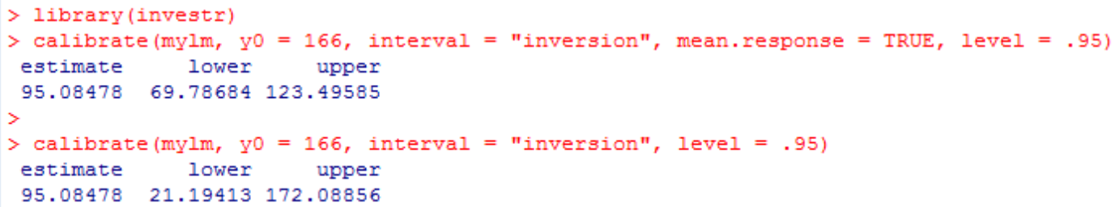
Calibration: R
Make sure and load the “investr” package first.
It is much easier to calculate calibration intervals in R.
*No calculations are required.

Slide 23
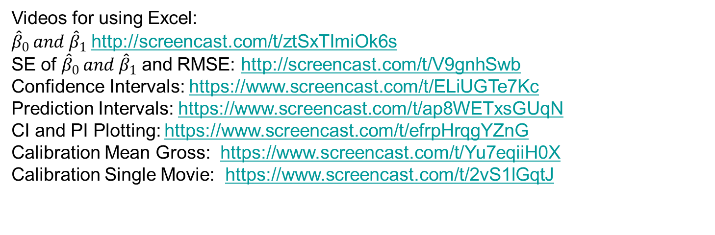
Worked Example: Calculating Regression Coefficients and Standard Errors
Videos for using Excel:
${\hat{β}}_{0 }and {\hat{β}}_{1}$ http://screencast.com/t/ztSxTImiOk6s
SE of ${\hat{β}}_{0 }and {\hat{β}}_{1}$ and RMSE: http://screencast.com/t/V9gnhSwb
Confidence Intervals: https://www.screencast.com/t/ELiUGTe7Kc
Prediction Intervals: https://www.screencast.com/t/ap8WETxsGUqN
CI and PI Plotting: https://www.screencast.com/t/efrpHrqgYZnG
Calibration Mean Gross: https://www.screencast.com/t/Yu7eqiiH0X
Calibration Single Movie: https://www.screencast.com/t/2vS1lGqtJ

Slide 24
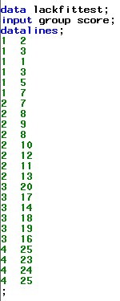
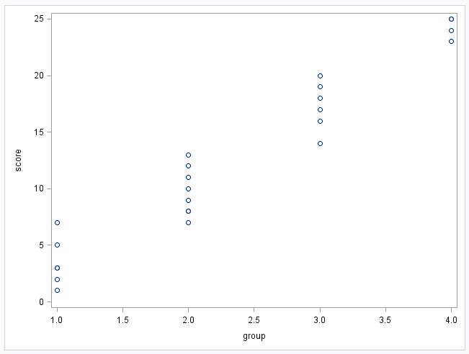
Lack of Fit Test

Slide 25
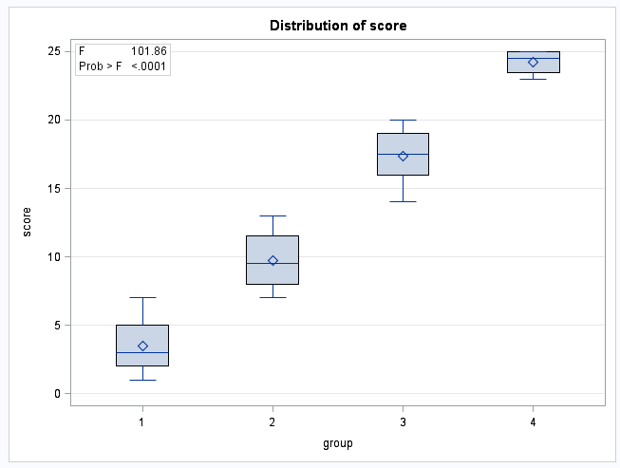
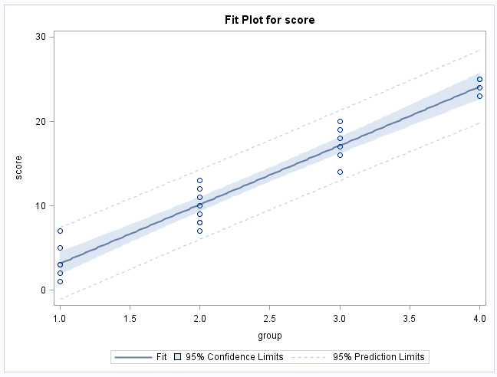
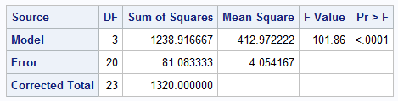
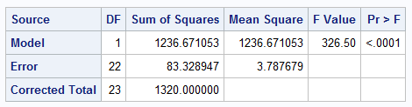


2 Models
Separate Means Model
Linear Regression Model
Note the difference in the Error DF and the Error Sum of Squares between the two models. Our Lack of Fit Test will be comparing these two models!
The question is, does the simple linear regression model do about as well with two parameters as the separate means model does with four?

Slide 26
Lack of Fit Test
Separate Means Model (SMM)
Linear Regression Model (LRM)
Source | DF | Sum of Squares | Mean Square =SS/df | F=MSM/MSE | Pr>F
Model
Error
Total
SMM
LRM

Slide 27
Lack of Fit Test
Separate Means Model (SMM)
Linear Regression Model (LRM)
Source | DF | Sum of Squares | Mean Square =SS/df | F=MSM/MSE | Pr>F
Model
Error
Total | 22 | 83.328947
SMM
LRM

Slide 28
Lack of Fit Test
Separate Means Model (SMM)
Linear Regression Model (LRM)
Source | DF | Sum of Squares | Mean Square =SS/df | F=MSM/MSE | Pr>F
Model
Error | 20 | 81.083333
Total | 22 | 83.328947
SMM
LRM

Slide 29
Lack of Fit Test
Separate Means Model (SMM)
Linear Regression Model (LRM)
Source | DF | Sum of Squares | Mean Square =SS/df | F=MSM/MSE | Pr>F
Model
Error | 20 | 81.083333
Total | 22 | 83.328947
SMM
LRM
df_{Model}=df_{Total}-df_{Error}=22-20=2
SS_{Model}=SS_{Total}-SS_{Error}=83.328947-81.083333=2.245614

Slide 30
Lack of Fit Test
Separate Means Model (SMM)
Linear Regression Model (LRM)
Source | DF | Sum of Squares | Mean Square =SS/df | F=MSM/MSE | Pr>F
Model | 2 | 2.245614
Error | 20 | 81.083333
Total | 22 | 83.328947
SMM
LRM
MS_{Model}=SS_{Model}/df_{Model}=2.245614/2=1.1228
MS_{Error}=SS_{Error}/df_{Error}=81.083333/20=4.0542

Slide 31
Lack of Fit Test
Separate Means Model (SMM)
Linear Regression Model (LRM)
Source | DF | Sum of Squares | Mean Square =SS/df | F=MSM/MSE | Pr>F
Model | 2 | 2.245614 | 1.1228
Error | 20 | 81.083333 | 4.0542
Total | 22 | 83.328947
SMM
LRM
F=MSM/MSE=1.1228/4.0542=0.2769

Slide 32


Lack of Fit Test
Separate Means Model (SMM)
Linear Regression Model (LRM)
Source | DF | Sum of Squares | Mean Square =SS/df | F=MSM/MSE | Pr>F
Model | 2 | 2.245614 | 1.1228 | .2769
Error | 20 | 81.083333 | 4.0542
Total | 22 | 83.328947
SMM
LRM
data mypvalue;
pval=1-probf(0.2769, 2, 20);
run;
proc print data = mypvalue;
run;

Slide 33
Lack of Fit Test
Separate Means Model (SMM)
Linear Regression Model (LRM)
Source | DF | Sum of Squares | Mean Square =SS/df | F=MSM/MSE | Pr>F
Model | 2 | 2.245614 | 1.1228 | .2769 | .7610
Error | 20 | 81.083333 | 4.0542
Total | 22 | 83.328947
SMM
LRM

Slide 34
Lack of Fit Test
Separate Means Model (SMM)
Linear Regression Model (LRM)
Source | DF | Sum of Squares | Mean Square =SS/df | F=MSM/MSE | Pr>F
Model | 2 | 2.245614 | 1.1228 | .2769 | .7610
Error | 20 | 81.083333 | 4.0542
Total | 22 | 83.328947
SMM
LRM
H_{o}: Linear regression model has good fit (No lack of fit.)
H_{a}: The separate means model fits better (Linear regression model is lacking fit.)
Conclusion: There is not enough evidence to suggest the linear regression model has a lack of fit with respect to the separate means model.
****Note: The description in the book uses the Sum of Squares Model. Given our study of ANOVA, this is likely an easier way to think about it. The tests are equivalent.

Slide 35
Breakout!

Slide 36
Lack of Fit Test
A company wants to look at sales volume (in $M) for various stores for three different months. Perform a lack of fit test (at significance level 0.05) to determine if the separate means model (using three parameters) is significantly better than the linear regression model (using two parameters).
You may want to copy the blank ANOVA table on paper.
DO NOT plug the data into any software.
H_{o}: Linear Regression Model Has Good Fit (No lack of fit.)
H_{a}: The separate means model fits better (Linear Regression Model is Lacking Fit.)
Month | Sales
1 | 2.678969
1 | 6.452194
1 | 1.837394
1 | 6.108601
1 | 5.369281
2 | 1.766862
2 | 6.898837
2 | 1.579677
2 | 3.726494
2 | 8.953184
3 | 8.680436
3 | 9.931636
3 | 6.691443
3 | 11.39723
3 | 14.93447
Source | df | SS | MS | F | Pr > F
^{Model (Difference)} | 1 | 26.5 | 26.5/1=26.5 | 3.24
_{Error (ANOVA)} | 12 | 98.2 | 8.18
_{Total (Regression)} | 13 | 124.7 | 9.59
Source | df | SS | MS | F | Pr > F
_{Total (Regression)} | 13 | 124.7 | 9.59
Source | df | SS | MS | F | Pr > F
^{Model (Difference)} | 1 | 26.5 | 26.5/1=26.5
_{Error (ANOVA)} | 12 | 98.2 | 8.18
_{Total (Regression)} | 13 | 124.7 | 9.59
Source | df | SS | MS | F | Pr > F
_{Error (ANOVA)} | 12 | 98.2 | 8.18
_{Total (Regression)} | 13 | 124.7 | 9.59
Source | df | SS | MS | F | Pr > F
^{Model (Difference)} | 1 | 26.5
_{Error (ANOVA)} | 12 | 98.2 | 8.18
_{Total (Regression)} | 13 | 124.7 | 9.59
Source | df | SS | MS | F | Pr > F
^{Model (Difference)} | 1 | 26.5 | 26.5/1=26.5 | 3.24 | 0.10
_{Error (ANOVA)} | 12 | 98.2 | 8.18
_{Total (Regression)} | 13 | 124.7 | 9.59
Source | df | SS | MS | F | Pr > F
At significance level alpha = 0.05, there is insufficient evidence that the separate means model is a significantly better fit than the linear regression model (p-value = 0.10).

Slide 37
Appendix

Slide 38
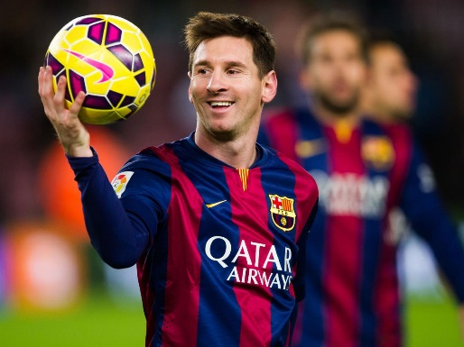
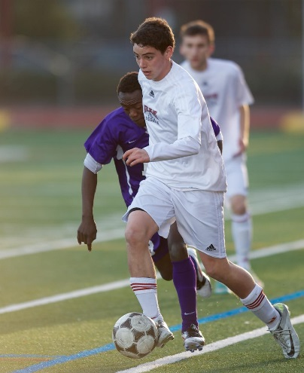
Heuristic Description
You are picking your players for a soccer team. You don’t get to see any of your prospects play … but you do get a piece of relative information. Which piece of information would be most useful to you?
Messi
Portuguese National Team
1. The player’s skills are indistinguishable from Messi’s (He is as good or almost as good as Messi.)
LACK OF FIT TEST
2. The player is better than John.
ANOVA
“The Player” = Your model.
“John” = Equal Means model
“Messi” = Separate Means Model
John
W.T. White H.S. Soccer Team

Slide 39
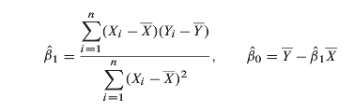
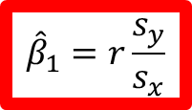
Movies!!! (Parameter Estimates)
$${\hat{β}}_{1}=r\frac{s_{y}}{s_{x}}$$
Regression Coefficent Calculation Example or Movie Data
x | y | (x-xbar)^2 | (y - ybar)^2 | (x-xbar)*(y-ybar) | Mean x | Mean y
62 | 65 | 760.183673 | 6700.591837 | 2256.918367 | 89.57143 | 146.8571
90 | 64 | 0.18367347 | 6865.306122 | -35.51020408
50 | 48 | 1565.89796 | 9772.734694 | 3911.918367
35 | 57 | 2978.04082 | 8074.306122 | 4903.632653
200 | 601 | 12194.4694 | 206245.7347 | 50150.34694 |  | Beta 1
100 | 146 | 108.755102 | 0.734693878 | -8.93877551 |  | 3.47209
90 | 47 | 0.18367347 | 9971.44898 | -42.79591837 |  | Beta 0
 |  | 17607.7143 |  | 61135.57143 |  | -164.14
Equation of Regression Line:
Pred Gross = 3.472 * Budget – 164.14

Slide 40
Confidence Intervals
Typo in book; should read df = n-2.
Confidence Intervals
Budgets | Est Value | SE Est Value | Lower Lim | Upper Lim
35 | -42.61978 | 46.9740057 | -163.370303 | 78.13074882
65 | 61.542928 | 35.3959431 | -29.4452408 | 152.531096
95 | 165.70563 | 31.9718347 | 83.5194147 | 247.8918499
125 | 269.86834 | 38.9170078 | 169.828984 | 369.9076903
155 | 374.03104 | 52.2482405 | 239.722664 | 508.3394195
185 | 478.19375 | 68.3244731 | 302.560097 | 653.8273956
200 | 530.2751 | 76.8670268 | 332.682116 | 727.8680814

Slide 41
Confidence Intervals
Typo in book; should read df = n-2.
Confidence Intervals
Budgets | Est Value | SE Est Value | Lower Lim | Upper Lim
35 | -42.61978 | 46.9740057 | -163.370303 | 78.13074882
65 | 61.542928 | 35.3959431 | -29.4452408 | 152.531096
95 | 165.70563 | 31.9718347 | 83.5194147 | 247.8918499
125 | 269.86834 | 38.9170078 | 169.828984 | 369.9076903
155 | 374.03104 | 52.282405 | 239.722664 | 508.3394195
185 | 478.19375 | 68.3244731 | 302.560097 | 653.8273956
200 | 530.2751 | 76.8670268 | 332.682116 | 727.8680814
We are 95% confident that the mean gross when the budget is $95 million is between $83 and $247 million.
We are 95% confident that the mean gross when the budget is $185 million is between $303 and $654 million.

Slide 42
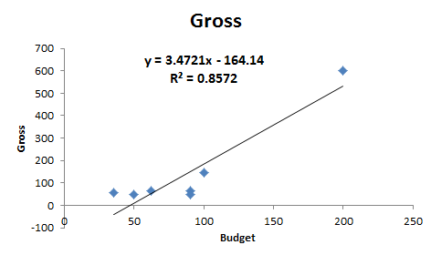

Movies!!! (Hypothesis Test)
Hypothesis Test for Movie Data
sample sd of x |  | Estimated Value | Residual | Resid^2 | MSE |  | SE Beta1 | SE Beta 0
54.17212427 |  | 51.12665715 | 13.87334 | 192.4696 | 84.09833 |  | 0.633776 | 65.06146
 |  | 148.3451815 | -84.3452 | 7114.11
 |  | 9.461575284 | 38.53842 | 1485.21 |  |  | t Beta 1 | t Beta 0
 |  | -42.61977705 | 99.61978 | 9924.1 |  |  | 5.478418 | -2.52289
 |  | 530.2750986 | 70.7249 | 5002.012
 |  | 183.066083 | -37.0661 | 1373.895
 |  | 148.3451815 | -101.345 | 10270.85
 |  |  |  | 35362.6
$$\hat{σ}$$

Slide 43
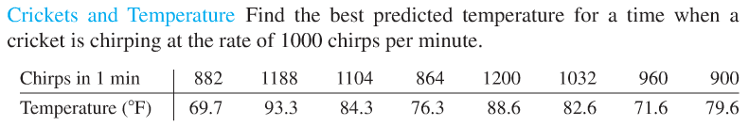
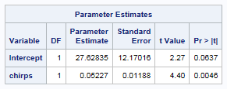
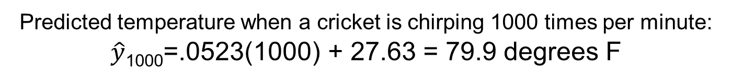
Crickets: Regression Eqn!!!
Equation of Regression Line:
Pred Temp =.0523 * Chirps + 27.63
Predicted temperature when a cricket is chirping 1000 times per minute:
$\hat{y}$₁₀₀₀=.0523(1000) + 27.63 = 79.9 degrees F
Thus when a cricket is chirping at 1000 chirps per minute the best predicted temperature is around 79.9 degrees F.

Slide 44
Crickets: confidence intervals!!!
Find the 95% confidence interval for the mean temperature when the observed cricket chirps are 1188.

Slide 45
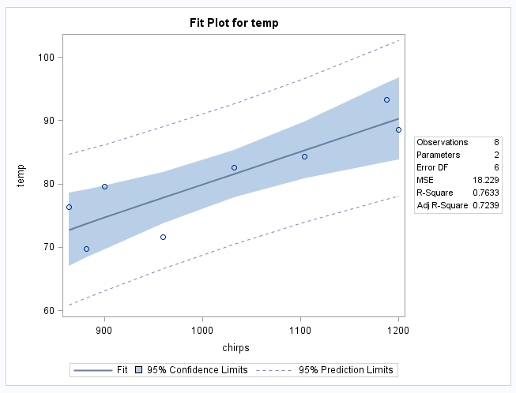
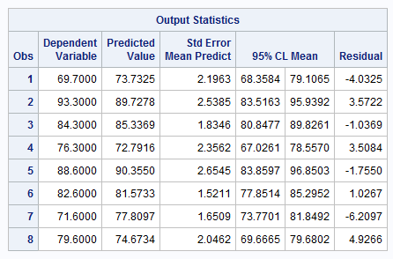

Crickets: confidence intervals
We are 95% confident that the mean temperature when the observed chirps are 1188 per minute is between 84 and 96 degrees.

Slide 46
Crickets: prediction intervals!!!
Find the 95% prediction interval for the temperature when the observed cricket chirps per min are 1188.

Slide 47
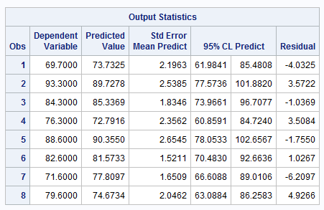

Crickets: prediction intervals
We are 95% confident that the temperature when the observed chirps are 1188 per minute is between 78 and 102 degrees.

Slide 48
Crickets: prediction intervals!!!
Find the 95% prediction interval for the temperature when the observed cricket chirps per min are 1000.

Slide 49
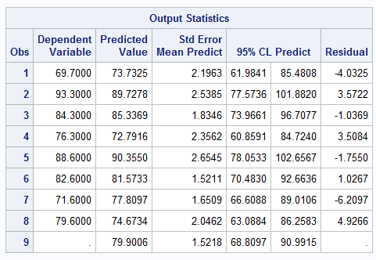
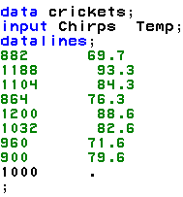
Crickets: prediction intervals
Find a 95% prediction interval for the temperature for 1000 chirps.
We are 95% confident that the temperature when the observed chirps are 1000 per minute is between 68.8 and 90.99 degrees.

Slide 50
Crickets: calibration interval!!!
Find the 95% calibration interval for the cricket chirps per minute that will indicate a mean temperature of 80 degrees.

Slide 51
Crickets: calibration interval
We are 95% confident that the required chirps per minute to indicate a mean temperature of 80 degrees is between approximately 935 and 1125.

Slide 52
Crickets: calibration interval!!!
Find the 95% calibration interval for the cricket chirps per minute that will indicate a temperature of 80 degrees.

Slide 53
Crickets: calibration intervals
We are 95% confident that the required chirps per minute to indicate predict a temperature of 80 degrees is between approximately 775 and 1225.

Slide 54
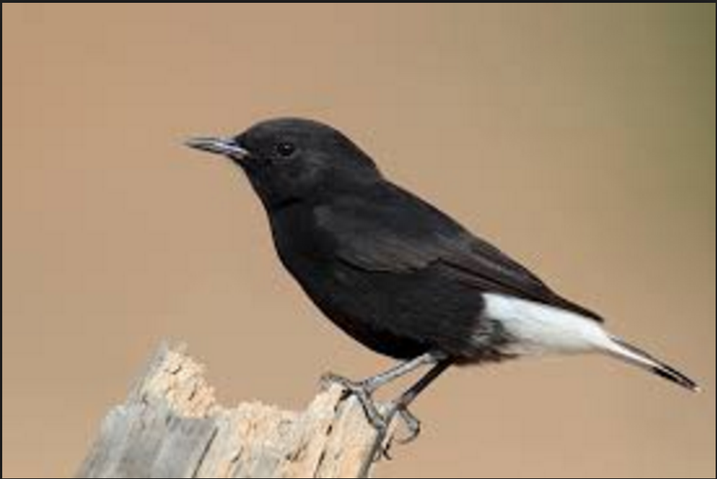
UNIT 10 HW: Simple Linear Regression (SLR)

